Slide 1
Income Census of The American Population
space for
your logo
A subtitle can make this more comprehensible

Slide 2
INCOME CENSUS OF
THE AMERICAN POPULATION

Slide 3
INTRODUCTION
“
—Someone famous

Slide 4

INTRODUCTION
The information of 32,562 adults in the United States of America (USA) from 1994 are analyzed in this research. Gender, age, race, working class, education level, income, and other factors are all included in this study's analysis. In order to develop a conclusion for this study, the trend and other key facts are noted.
According to our research, by studying the feature significance of the US adult income dataset, we hope to gain a better understanding of its relevance. Between the dependent and independent variables, exploratory analysis will be performed.

Slide 5

PROJECT AIMS
The goal of the research is to examine the information on the income census of the population of the United States of America, as well as crucial components that should be highlighted for the upcoming research.

Slide 6
OBJECTIVES
Objective 1
Objective 2
Objective 3
To determine the Level of Income based on Education Level, Work Sector and Working Hours per Week
To determine the Work Sector based on Sex, Age and Occupation Type
To find the relationship between Income Status, Country of Origin, and Marital Status

Slide 7
Visual Description and Purposes

Slide 8
Visual Description and Purposes
6 | Working Sector by Occupation Type | Working sector and occupation attributes were used in the stacked bar chart. | To find the patterns of the working sector in America based on the type of occupation.
7 | American Population’s Country of Origin | Country origin attributes were used in the donut chart. | To display the country of origin in the American population.
8 | Marital Status by Average Age and Average Education | Marital status, age group and education level attributes were used in the line chart. | To find the relationship between marital status of Americans and the average age and education.
9 | Marital Status of American Citizen | Marital status attributes were used in the donut chart. | To discover the number of Americans for each marital status.
10 | Marital Status by Country of Origin and Income Status | Marital status, country origin and income attributes were used in the clustered column chart. | To compare the American population for each marital status based on their origin country and income status.
No | Title of Chart | Description | Purpose
1 | Level of Income by Education Level | Income and education level attributes were used in the 100% stacked bar chart. | To determine the pattern of level of income for each education level.
2 | Level of Income by Working Sector | Income and work sector attributes were used in the 100% stacked bar chart. | To determine the pattern of level of income for each working sector.
3 | Level of income by Working Hours | Income and working hours attributes were used in the 100% stacked bar chart. | To determine the pattern of level of income based on the working hours.
4 | American Population by Working Sector | Working sector attributes were used in the donut chart. | To display the American population in each working sector.
5 | Working Sector by Age Group and Sex | Working sector, sex and age group attributes were used in the stacked column chart. | To find the patterns of the working sector in America based on sex and age group.

Slide 9
Visual Description and Purposes
No | Title of Chart | Description | Purpose
1 | Level of Income by Education Level | Income and education level attributes were used in the 100% stacked bar chart. | To determine the pattern of level of income for each education level.
2 | Level of Income by Working Sector | Income and work sector attributes were used in the 100% stacked bar chart. | To determine the pattern of level of income for each working sector.
3 | Level of income by Working Hours | Income and working hours attributes were used in the 100% stacked bar chart. | To determine the pattern of level of income based on the working hours.
4 | American Population by Working Sector | Working sector attributes were used in the donut chart. | To display the American population in each working sector.
5 | Working Sector by Age Group and Sex | Working sector, sex and age group attributes were used in the stacked column chart. | To find the patterns of the working sector in America based on sex and age group.

Slide 10
Visual Description and Purposes
6 | Working Sector by Occupation Type | Working sector and occupation attributes were used in the stacked bar chart. | To find the patterns of the working sector in America based on the type of occupation.
7 | American Population’s Country of Origin | Country origin attributes were used in the donut chart. | To display the country of origin in the American population.
8 | Marital Status by Average Age and Average Education | Marital status, age group and education level attributes were used in the line chart. | To find the relationship between marital status of Americans and the average age and education.
9 | Marital Status of American Citizen | Marital status attributes were used in the donut chart. | To discover the number of Americans for each marital status.
10 | Marital Status by Country of Origin and Income Status | Marital status, country origin and income attributes were used in the clustered column chart. | To compare the American population for each marital status based on their origin country and income status.

Slide 11
Storytelling Narration

Slide 12
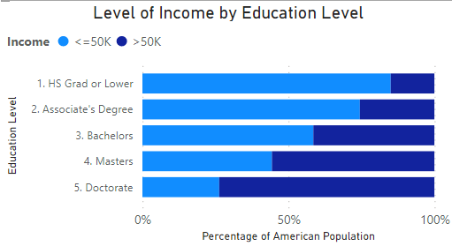
CHART 1: Level of Income by Education Level

Slide 13
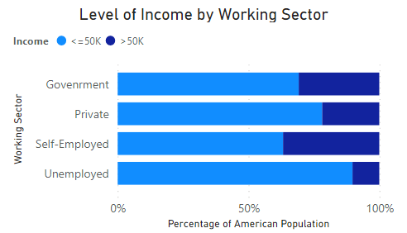
CHART 2: Level of Income by Working Sector

Slide 14
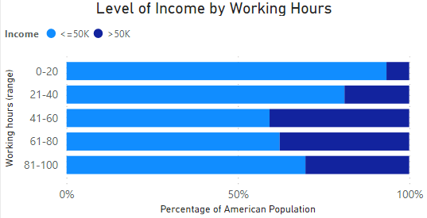
CHART 3: Level of Income by Working Hours

Slide 15
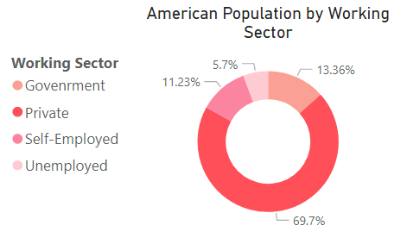
CHART 4: American Working Population by Working Sector

Slide 16
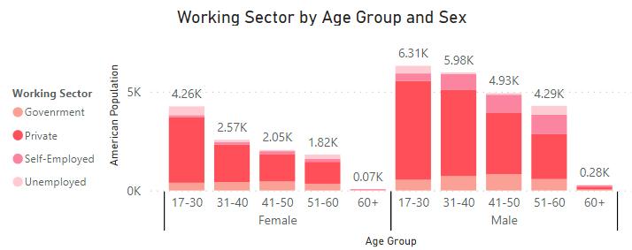
CHART 5: Working Sector by Age Group and Sex

Slide 17
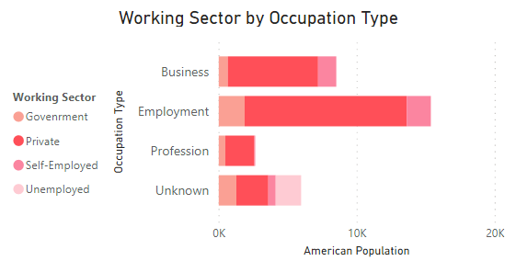
CHART 6: Working Sector by Occupation Type

Slide 18
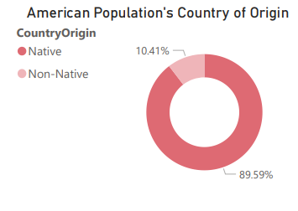
CHART 7: American Population’s Country of Origin

Slide 19
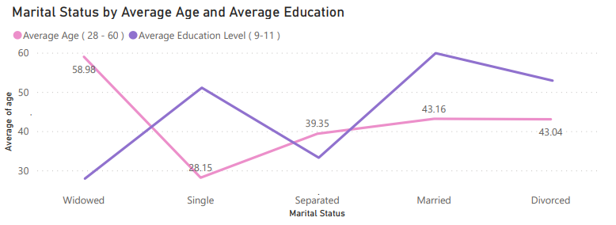
CHART 8: Marital Status by Average Age and Average Education

Slide 20
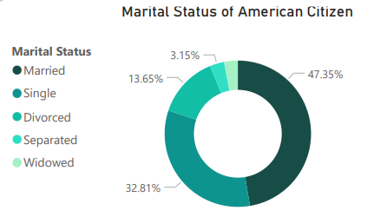
CHART 9: Marital Status of American Citizen

Slide 21
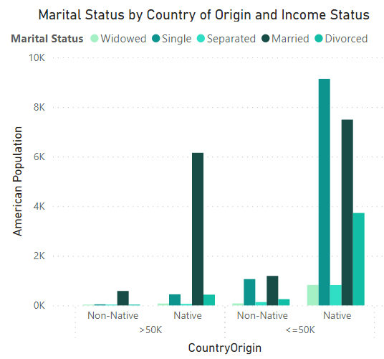
CHART 10: Marital Status by Country of Origin and Income Status

Slide 22
CONCLUSION

Slide 23
CONCLUSION
This data visualization approach has a wide range of applications.
All of the project's goals were met.
There are various phases to creating an efficient data visualization that makes the data simple to understand and leaves a lasting impression on the audience.
A few new properties have been established in order to simplify data visualization in a more understandable pattern.

